Slide 1
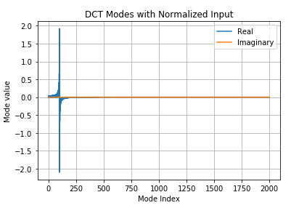
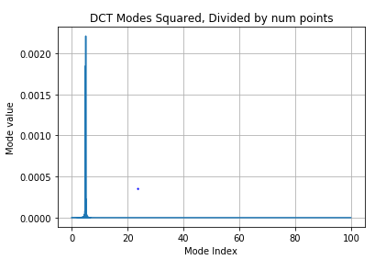
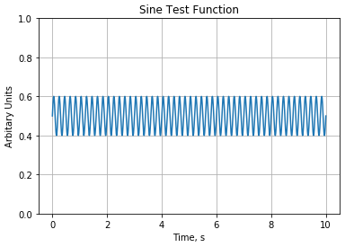
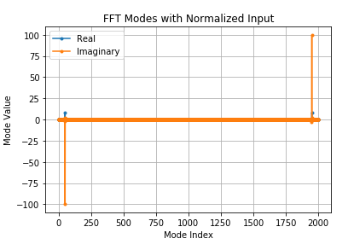
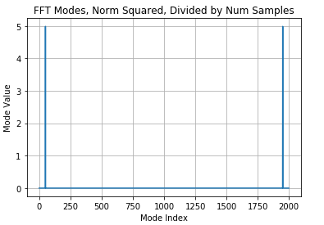
Comparing the Discrete Cosine Transform with the conventional FFT:
5 Hz, 0.1 amplitude

Slide 2
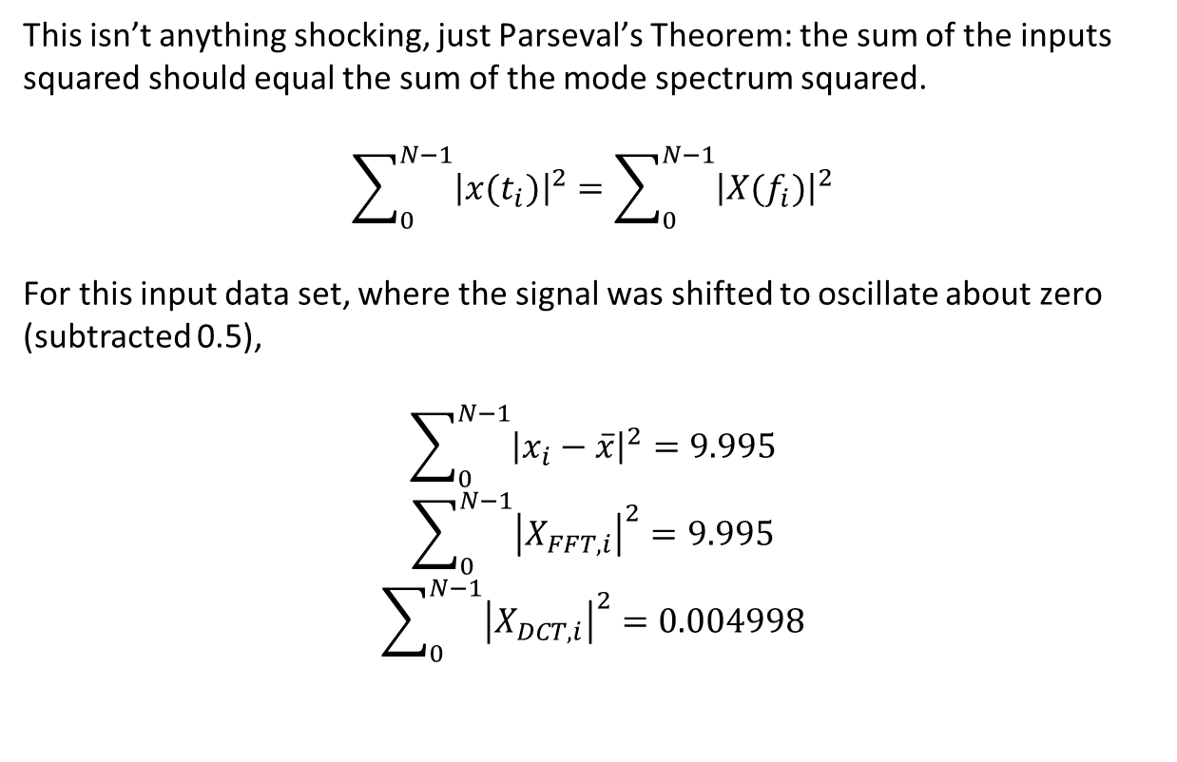
This isn’t anything shocking, just Parseval’s Theorem: the sum of the inputs squared should equal the sum of the mode spectrum squared.
$$\sum_{0}^{N−1}{{\left|x(t_{i})\right|}^{2}}=\sum_{0}^{N−1}{{\left|X(f_{i})\right|}^{2}}$$
For this input data set, where the signal was shifted to oscillate about zero (subtracted 0.5),
$$\sum_{0}^{N−1}{{\left|x_{i}−\overline{x}\right|}^{2}}=9.995$$
$$\sum_{0}^{N−1}{{\left|X_{FFT,i}\right|}^{2}}=9.995$$
$$\sum_{0}^{N−1}{{\left|X_{DCT,i}\right|}^{2}}=0.004998$$
I believe the problem is that the input x to the DCT must be normalized in a different manner for Parseval’s theorem to hold.
This normalization changes the input amplitudes, and it’s also different when considering that in pyGSTi, you’re dealing with binary values, not a continuous spectrum from the oscillating signal.

Slide 3
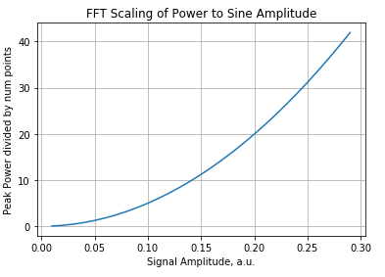
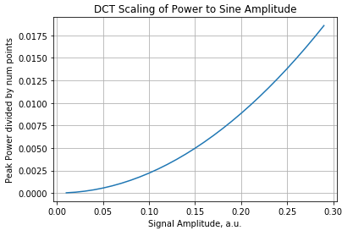
I’m not sure where this relationship comes from, but there’s a clear polynomial relationship between the sine amplitude and the peak power, divided by the total number of points.
The scale for the power between the FFT and DCT is quite different though.

